Slide 1
Data Warehouse Implementation Project
IS 549
Ramadan Gannud

Slide 2
Defining the 3 main stages of the DW:
Source: I will be using AdventureWorks2012 database Sample in Microsoft SQL Server 2014.
ETL: I will be using Microsoft SQL Server Integration Services platform (SSIS).
Target: I will be using Microsoft SQL Server 2014.

Slide 3
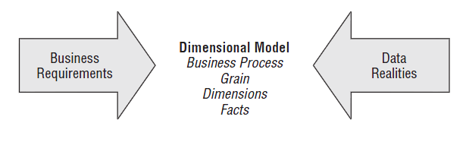
Steps to design the Dimensional Model:
1. Identify Organization’s Business Processes
2. Declare the Grain ( level of details )
3. Identify Dimensions. ( Who, What, Where, When, Why and How)
4. Identify Facts ( what is the process measuring ? )

Slide 4
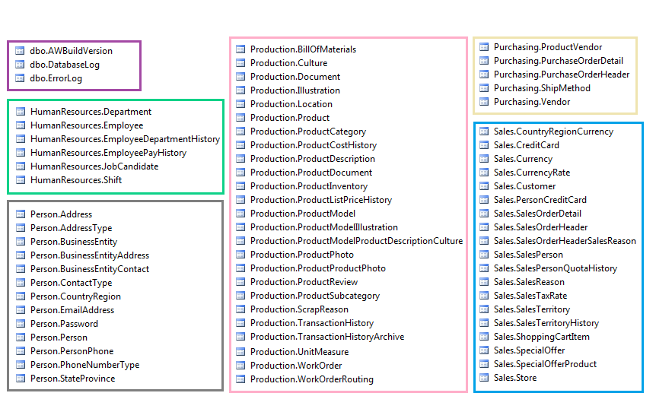
Data Source Tables

Slide 5
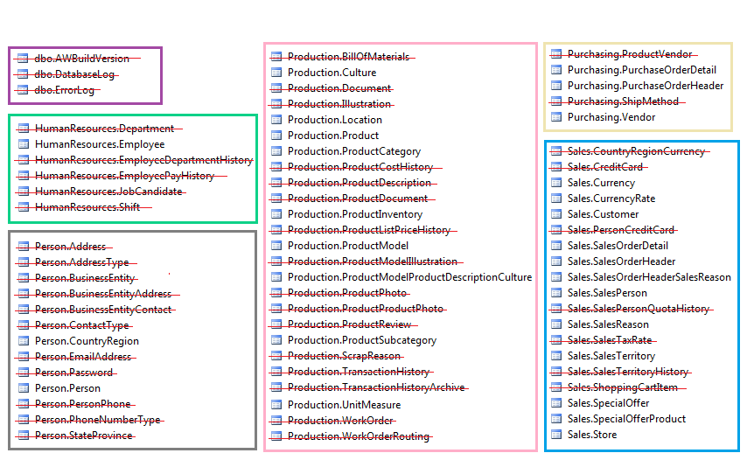
Taking off unnecessary Tables:

Slide 6
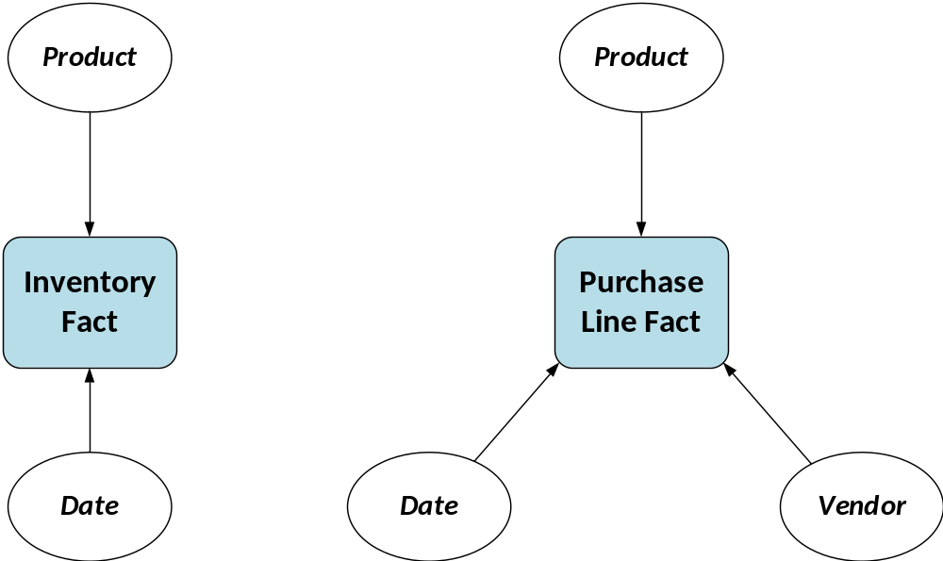
High level Star-Schemas

Slide 7
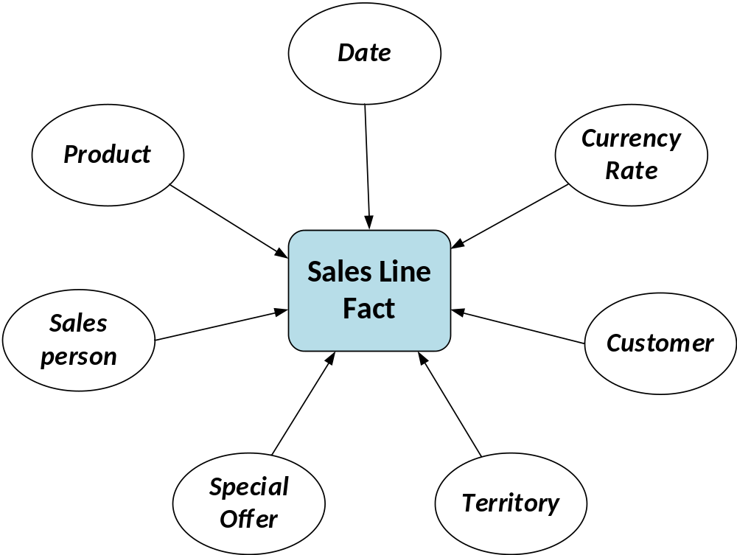

Slide 8
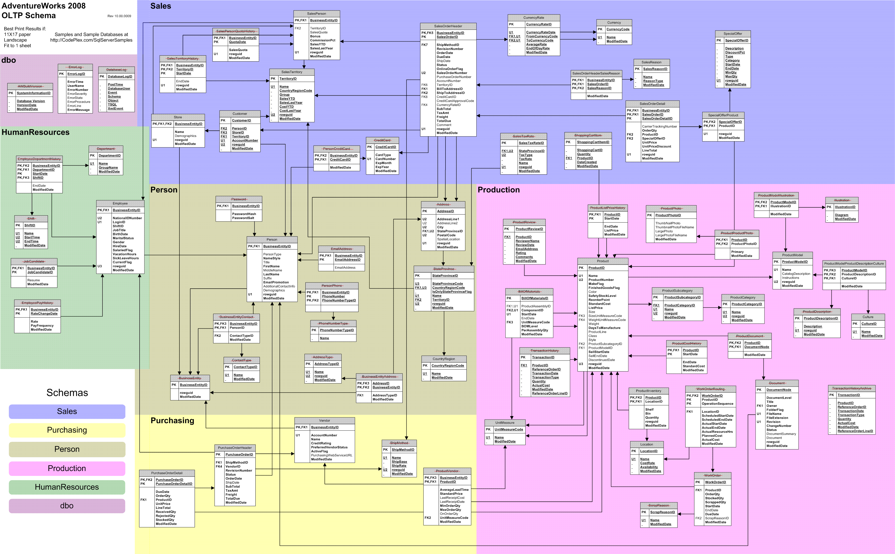

Slide 9
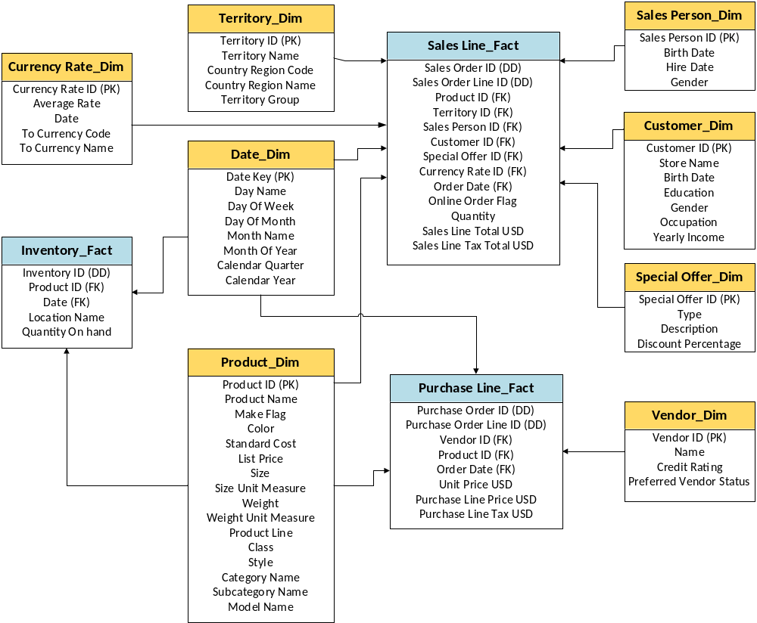

Slide 10
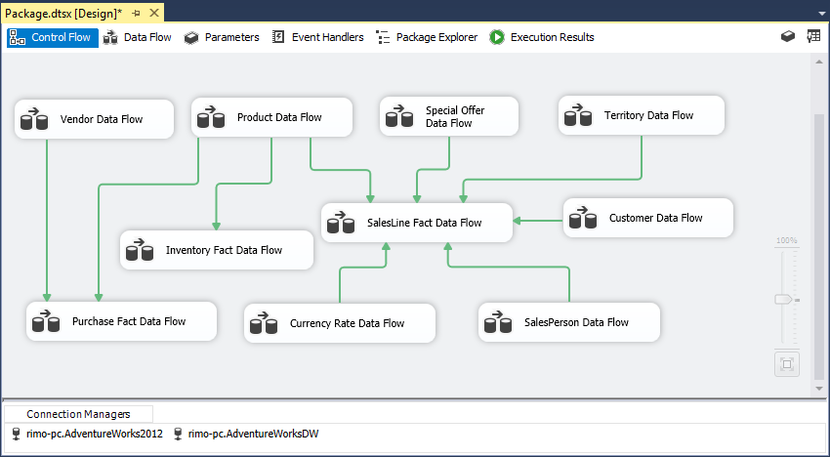
ETL Design in MS Visual Studio using SSDT
I first created my target DB (AdventureworksDW) as shown in my Dimensional model design. I then created two connection managers in visual studio to implement my ETL process using SQL Server Data Tools. One is to create a connection to my source DB and the other one is to create a connection to my target DB.

Slide 11
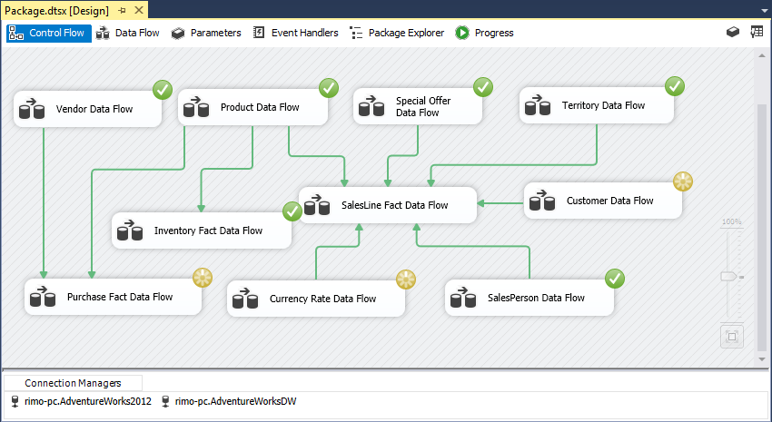
ETL Package while Debugging

Slide 12
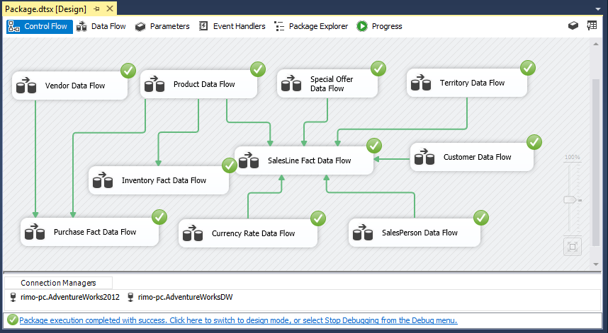
After ETL Process is done

Slide 13
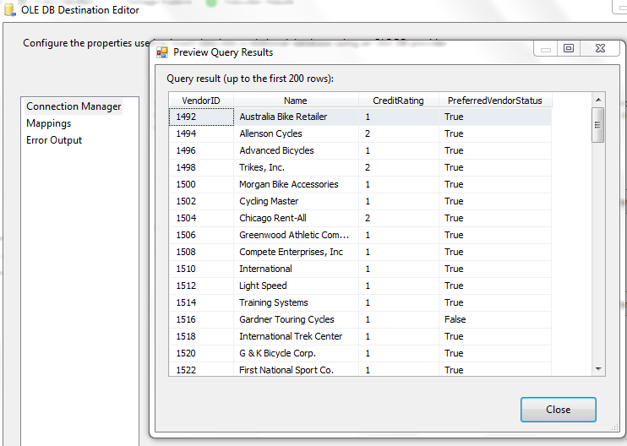
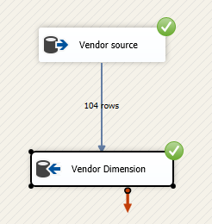
The Details of the ETL Process
Loading Vendor Dimension and its Data Results

Slide 14
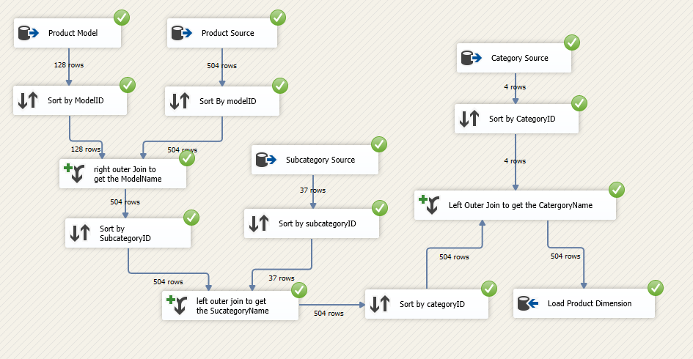
Loading Product Dimension

Slide 15
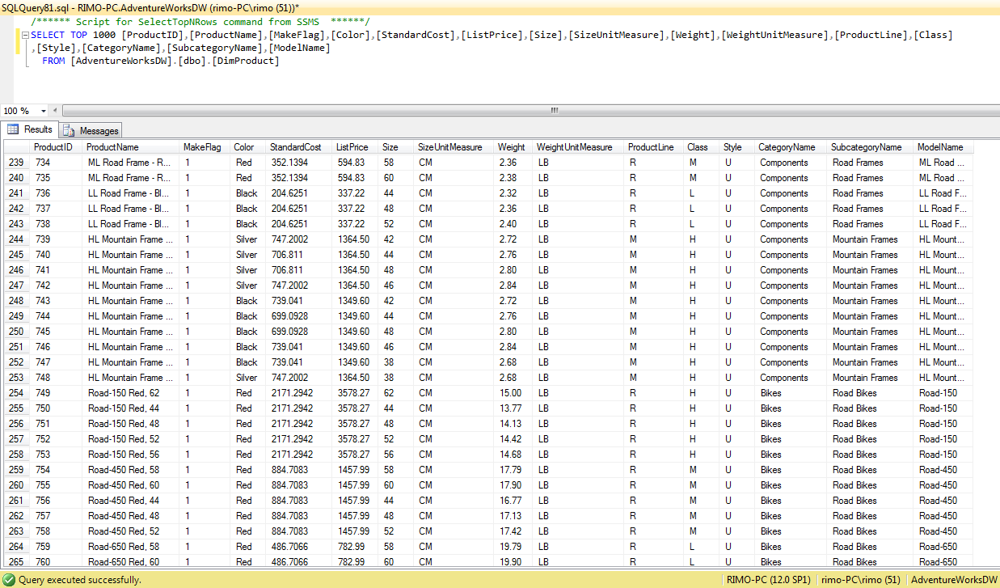
Product Dimension Data Results

Slide 16
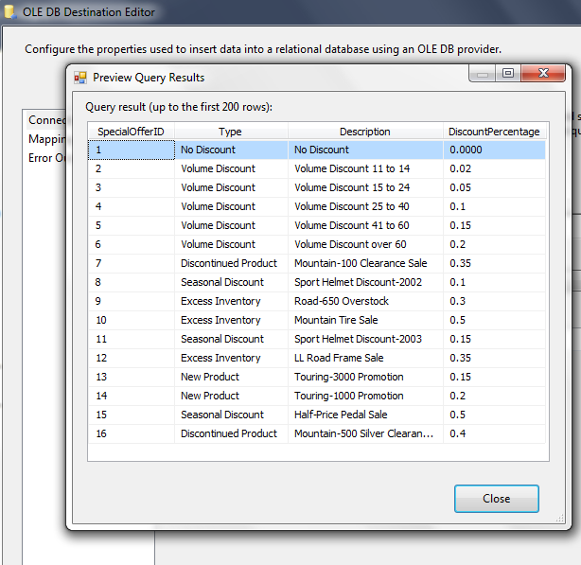
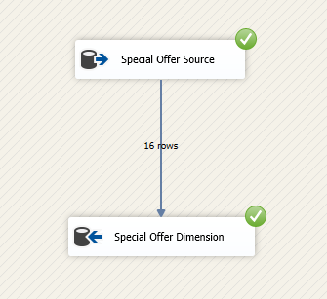
Loading Special Offer Dimension and its Data Results

Slide 17
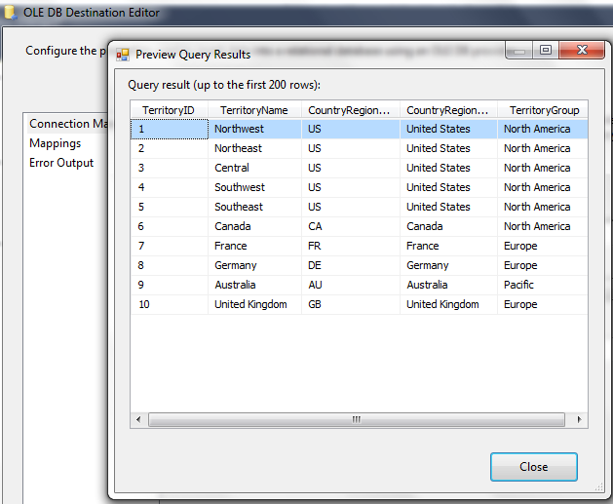
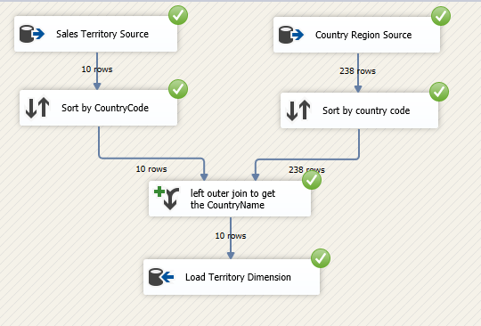
Loading Territory Dimension and its Data Results

Slide 18
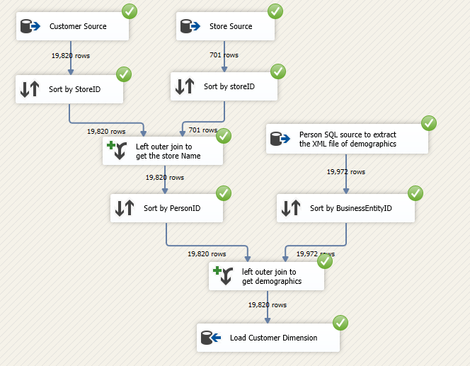
Loading Customer Dimension

Slide 19
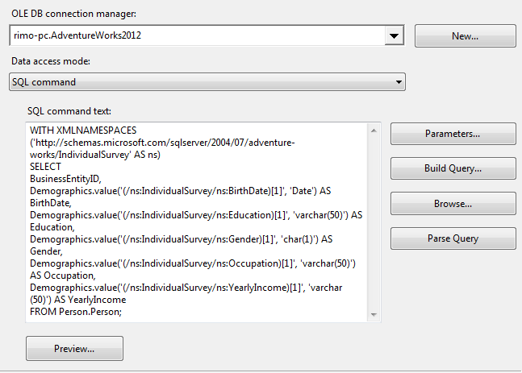
Demographic XML
Since Customer demographics are stored as an XML file in the source Database, I used a script to retrieve the required person demographics data from the source and extract the XML file. The picture shows the script I used to extract the demographics attribute.

Slide 20
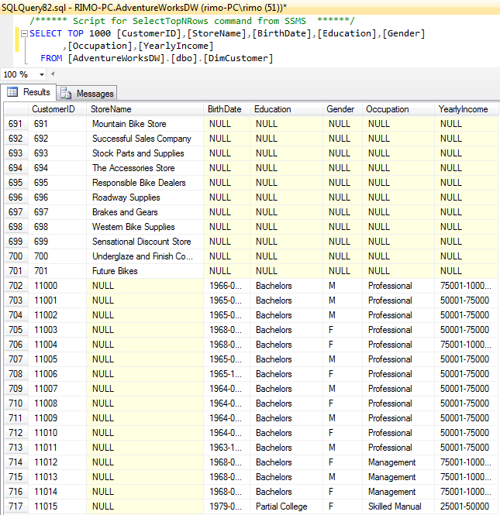
Customer Dimension Data Results
There are 701 stores stored as Customers and the rest are Individual customers. Store name attribute will be null whenever a customer is not a store and vice versa for other attributes as it’s shown in the picture

Slide 21
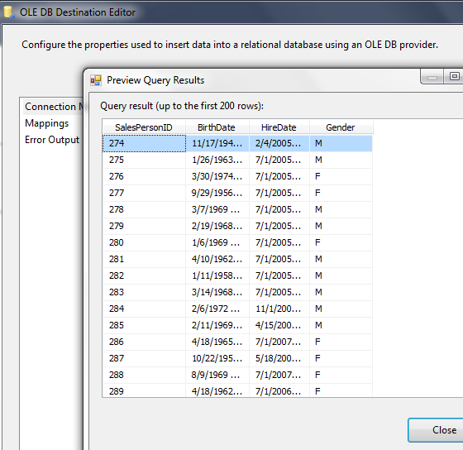
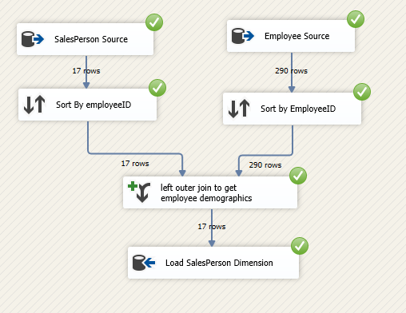
Loading Sales Person Dimension and its Data Results

Slide 22
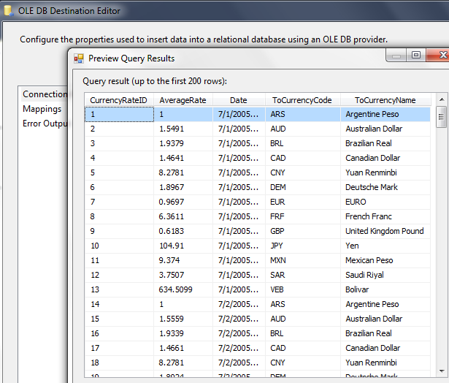
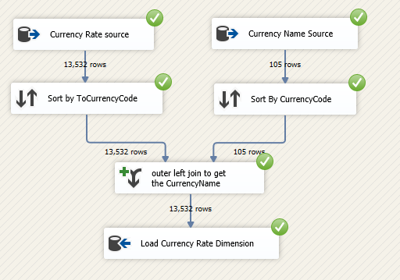
Loading Currency Rate Dimension and Data Results
Since our source database transfers only from the US currency to other currencies, I didn’t use FromCurrencyCode attribute.

Slide 23
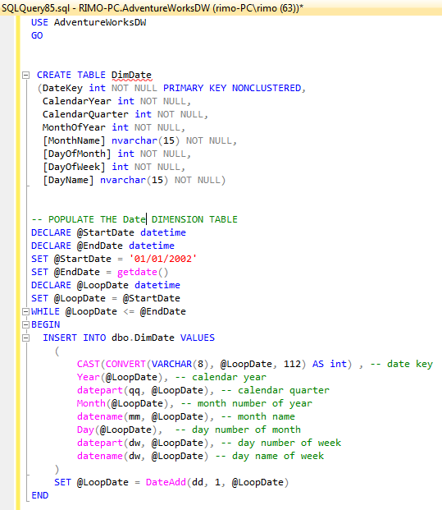
Date Dimension
After I created all dimension tables including the Date dimension table, and before I ran my ETL process, I populated the Date Dimension table with the appropriate data that has all dates the source database has up to present.

Slide 24
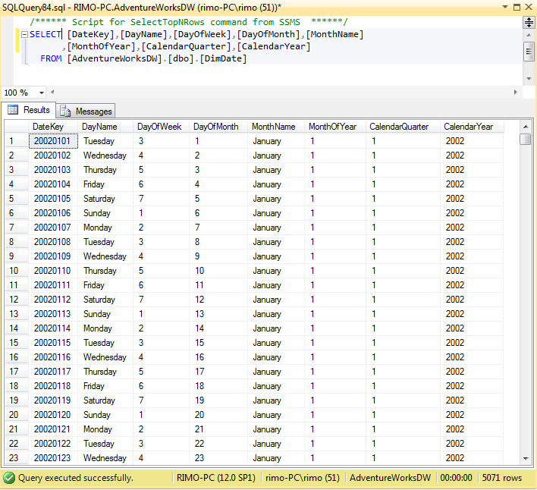
Date Dimension Data Results

Slide 25
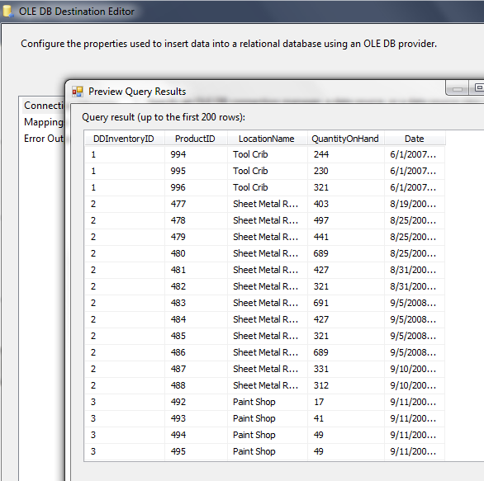
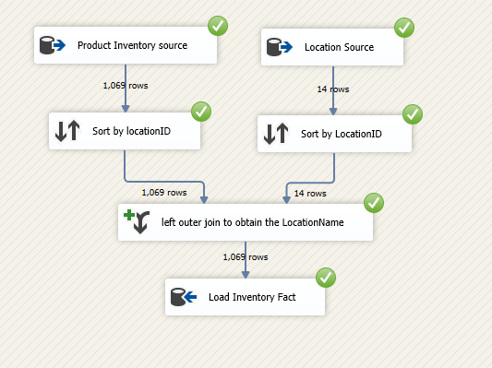
Loading Inventory Fact Table and its Data Results

Slide 26
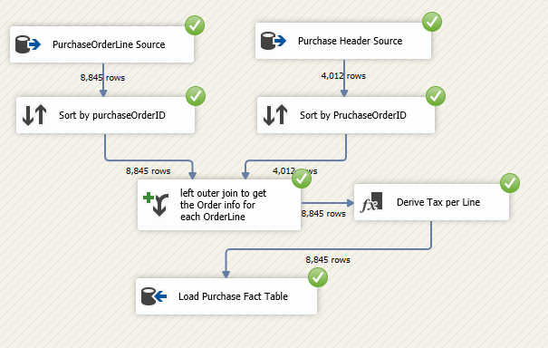
Loading Purchase Line Fact Table
Tax amount per Purchase Line is not calculated in the Adventure Works DB Sample source. Tax amount is existed only for each Purchase Order in the Purchase Order Header Table. Therefore, I will calculate the tax rate for each order and then apply it to each order line in that order, so I can get the tax amount for each purchase line.
Tax per purchase Line =
(Order Tax / Order Subtotal) * Line Total

Slide 27
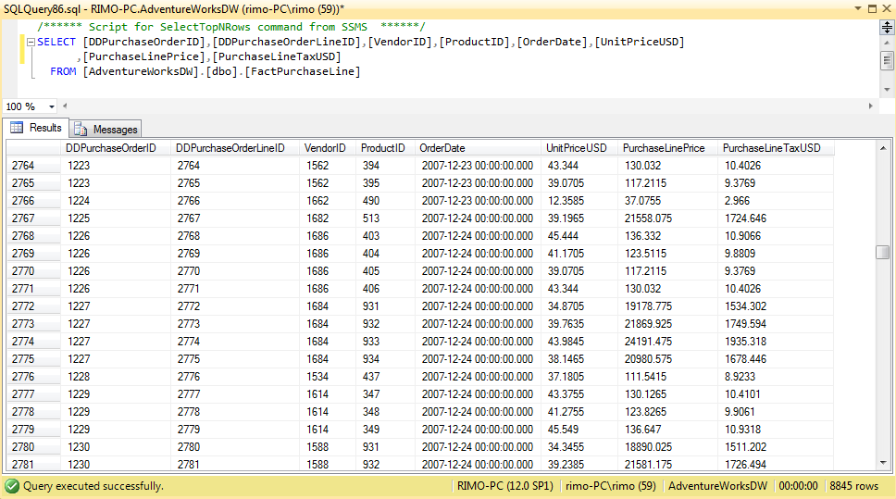
Purchase Line Fact Table Data Results

Slide 28
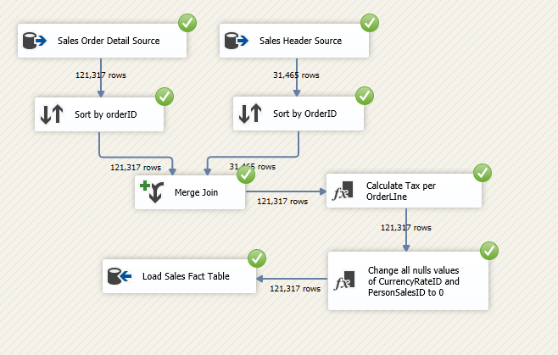
Loading Sales Line Fact Table
I did the same calculation I performed in the Purchase Fact to obtain the Tax per Line.
While I was looking at my source’s data closely, I realized that some orders have NULL CurrencyRateID and some other orders have NULL PersonSalesID. Since Fact tables don’t allow null values and I am using those two attributes as Foreign keys reference two of my dimensions in the Sales Fact Table, I decided to change those NULL values to 0 in my ETL process and populate a row represents that 0 value key in each dimension before I run my ETL package.

Slide 29
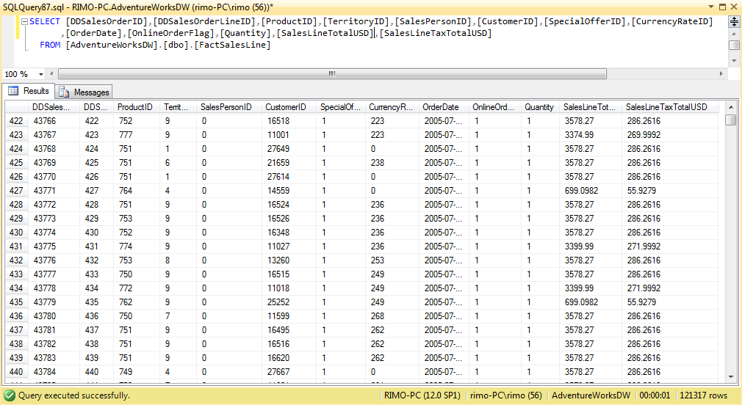
Sales Line Fact Table Data Results

Slide 30
Thank you :)

